Slide 1

Alpine: New User Seminar

Slide 2
CURC Alpine: New User Seminar
Instructor: Trevor Hall
Website: www.rc.colorado.edu
Helpdesk: rc-help@colorado.edu
Slides: https://github.com/ResearchComputing/New_User_Seminar
Survey: http://tinyurl.com/curc-survey18

Slide 3

RMACC Cyber Infrastructure Portal
https://ask.cyberinfrastructure.org/c/rmacc/65
This forum provides opportunity for RMACC members to converse amongst themselves and with the larger, global research computing community.
The “go to” general Q&A platform for the global research computing community - researchers, facilitators, research software engineers, CI engineers, sys admins and others.
Notes:
Stack exchange but for RC specifically

Slide 4
Learning Goals
Understand Basic CURC Resources & the Alpine cluster
Getting an account & logging in
Navigate the RC system
Running a job
Help!

Slide 5

Things to take note of:
Confusing, ambiguous, highly nuanced concepts
Our goal is to help you avoid common mistakes, pitfalls, and frustrations
Ask Questions!

Slide 6


Resources Include:
High Performance Computing (HPC)
Storage of Research Data
High-Speed Data Transfer
Data Sharing
Cloud Computing
Training and Education
Secure Research
Notes:
Can advise on Secure Research, have a CMMC environment (Preserve) available (let know available if doing DoD or DoE things)

Slide 7

Primarily known for:
High Performance Computing (HPC)

Slide 8

High Performance Computing (HPC)
vs. Traditional Computing
Traditional computing generally has access to a single processor (perhaps multiple cores)

Slide 9
What can I use HPC for?
Solving large problems that require more:
Memory than you have on your PC
cores/nodes/power thank you have on your PC
Jobs that require hardware you may not have:
High Performance GPU computing
Specific Operating System
Visualization rendering

Slide 10
What can I use HPC for?
Jobs that would take a long time on local machines can instead be distributed over hardware:
Parallelized to split up then joined (if software enabled)
Broken up into many serial jobs
BIG Job
Results
Tiny Job
Tiny Job
Results
Tiny Job

Slide 11
Research Computing Resources

Slide 12
HPC Cluster: Alpine
Alpine is the 3rd-generation HPC cluster at CURC, following:
Janus
RMACC Summit
Alpine is a heterogeneous cluster with hardware currently provided by CU Boulder, CSU, and Anschutz
Access available to CU Boulder, CSU, AMC and RMACC users
Alpine

Slide 13
HPC Cluster: Alpine
Hardware on Alpine will continue to be purchased and released in stages:
Alpine (stage 4):
256 General CPU Nodes
AMD Milan, 64 Core, 3.74G RAM/Core
12 NVIDIA GPU Nodes
3x NVIDIA A100 (atop General CPU node)
8 AMD GPU Nodes
3x AMD MI100 (atop General CPU node)
22 AMD High-Memory Nodes
AMD Milan, 48 Core, 21.5G RAM/Core
Additional Hardware contributed by CSU, AMC
Nodes which boost priority for CSU/AMC users
Alpine
Notes:
AMC – must sign end user agreement

Slide 14
HPC Cluster: Alpine
Interconnect
CPU nodes: HDR-100 InfiniBand (200Gb inter-node fabric)
GPU nodes: 2x25 Gb Ethernet +RoCE
Scratch Storage: 25Gb Ethernet +RoCE
Operating System
RedHat Enterprise Linux version 8 operating system
Alpine

Slide 15
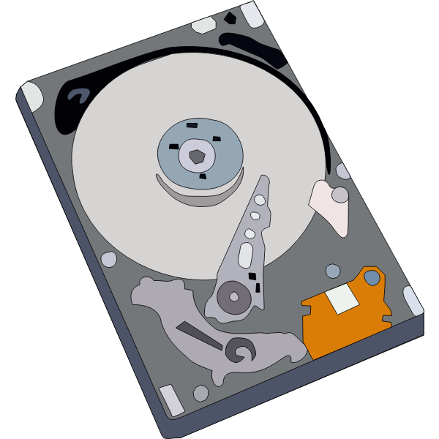

Storage at CURC
PetaLibrary
Local or Cloud
Core
Included with RC account
/home
/projects
scratch space
You can download your data locally or to a variety of other cloud resources
Cloud Foundations at Research Computing
Paid Service for:
Storage
Archive
Sharing of research data
Notes:
CU Research Computing hosts a free-to-use on-premise cloud service, called CUmulus, which supports cases not well-suited for HPC such as webservers, databases, and long-running services. The CUmulus service includes access to a Virtual Private Cloud (VPC) which provides users with a logically isolated section of the cloud with a small number of outside routable floating IP addresses. Within this VPC customers will be given an allocation of:
CPU cores
Memory
Storage

Slide 16
Data Sharing: Within RC
Sharing workspaces
Project space
Scratch Space
PetaLibrary Space*
*If you have purchased PetaLibrary space
Notes:
Highlight not sharing home space
Where configs are at, people can mess with them

Slide 17
Data Sharing: Outside RC
Globus (recommended):
GUI Web Application
Automates large transfers
Resumes failed transfers
Distributes large transfers across DTNs
Endpoints that can shared
Data Transfer Nodes (DTN)
Internal CU network needed (VPN)
Command line tools
scp, sftp, rsync, rclone

Slide 18

Cloud Computing
CURC supports both AWS and on-premise cloud via CUmulus
For use cases not well-supported by HPC
Can be used as an alternative to HPC
Can be used to enhance HPC
Automatic job submission, high availability, etc.
Request a CUmulus application by contacting the RC helpdesk at rc-help@colorado.edu
Notes:
Cloudbursting

Slide 19
Accessing Research Computing

Slide 20
How to Access RC Resources?
Get an RC account
Set up two-factor authentication with Duo
(Inform us of any specific needs)
Log in
Create greatness! (responsibly)

Slide 21
Getting an RC Account
University of Colorado, Boulder users and affiliates:
Request an account through the RC Account request portal
https://rcamp.rc.colorado.edu/accounts/account-request/create/organization
Colorado State University users:
Request an CSU eID if you don’t have one
Fill out account application form
Duo authentication
https://it.colostate.edu/research-computing-and-cyberinfrastructure/compute/get-started-with-alpine/
CU Anschutz Users:
Create an ACCESS-CI Account in the ACCESS user portal
Reach out to hpcsupport@cuanschutz.edu to receive and sign the End-User Agreement
RMACC Users:
Create an ACCESS-CI Account in the ACCESS user portal
Email us at rc-help@colorado.edu and request an account. Please include the following information: your ACCESS username, your institutional affiliation, your role, your department, your first and last name, your preferred email address for communication

Slide 22
Demo: Getting an Account
CU Boulder, CSU users and affiliates:
Request an account through the RC Account request portal:
https://rcamp.rc.colorado.edu/accounts/account-request/create/organization
AMC, RMACC users and affiliates:
Request an account through the ACCESS-CI User Registration Portal:
https://identity.access-ci.org/new-user.html

Slide 23
Your RC Account
Access to:
Alpine Cluster
Core Storage
PetaLibrary Storage*
Open OnDemand
Approximately 2,000 Service Units (SUs) per month
*If purchased
Notes:
https://ondemand.rc.colorado.edu/
https://ondemand-rmacc.rc.colorado.edu/

Slide 24
Your RC Account
How can I use more computational time?:
Trailhead Allocation (Default)
~2,000 SUs / Month
Ascent Allocation
250,000 SUs
Peak Allocation
>250,000 SUs
Request an allocation at https://curc.readthedocs.io/en/latest/clusters/alpine/allocations.html?highlight=alpine%20allocation#comparing-trailhead-auto-allocation-ascent-allocation-and-peak-allocation-tiers

Slide 25
Two Factor Authentication (Duo)
Provides an extra level of authentication
We are outside the firewall!
Valuable resources
Inviting, high-profile target
Lost time investigating/fixing
Duo
You will receive a Duo invitation when your RC account is created

Slide 26
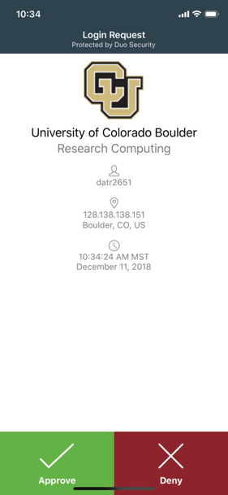
Duo Authentication
Duo smartphone app (recommended)
Phone Call/Text is an alternatives
Physical code generator “token” available for $20

Slide 27
Linux comfort level check
On a scale from (1-10) how familiar/comfortable are you with Linux?
The command line
Basic commands
Linux filesystem
Navigating the filesystem

Slide 28
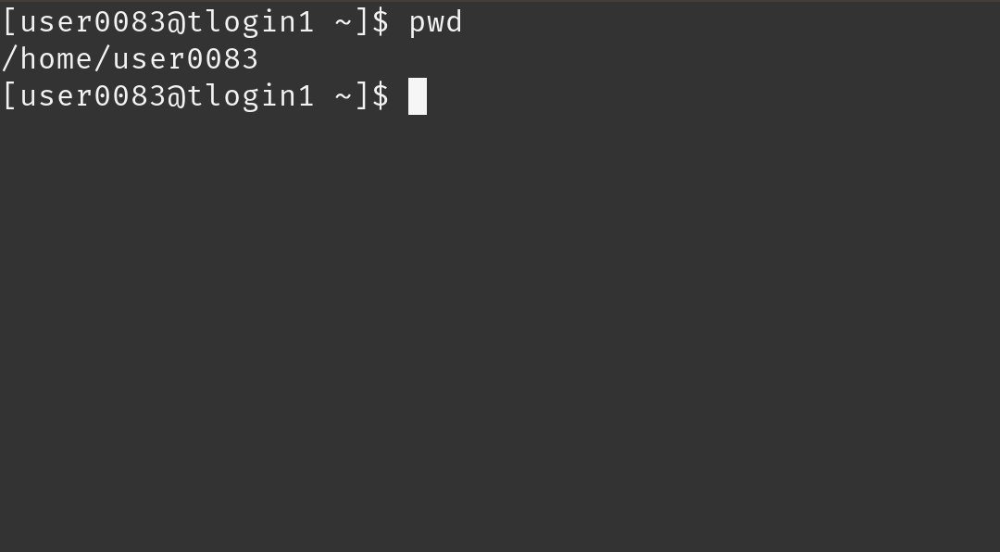
Terminal
Mac or Linux
Terminal application
Windows
PuTTY
Powershell
Open OnDemand (alternative for CU affiliates)
For those less familiar with Linux (ondemand.rc.colorado.edu/)

Slide 29
Demo: Logging in via Terminal
To login to an RC login node:
$ ssh <username>@login.rc.colorado.edu
Supply your IdentiKey password and your Duo app will alert you to confirm the login
*CU and CSU exclusive

Slide 30
Demo: logging in with OnDemand
CURC Open OnDemand is a browser based, integrated, single access point for all of your HPC resources at CU Research Computing.
CU Boulder: Visit https://ondemand.rc.colorado.edu.
Other RMACC Institutions: Visit https://ondemand-rmacc.rc.colorado.edu/

Slide 31
Logging In
It’s important to note that you are NOT logging into any specific resource, Alpine, Blanca, etc.
When you log in, you land on our login nodes
From there, you can access our other resources:
Alpine
Blanca
Petalibrary

Slide 32
Navigating Research Computing

Slide 33
Node | File System
One computing server Physical hardware Work together in parallel | The basic tree-like layout From most nodes* you have access to most file systems
/
d1
d2
d3
d4
f1
f2

Slide 34
Node | File System
One computing server Physical hardware Work together in parallel | The basic tree-like layout From most nodes* you have access to most file systems
/
d1
d2
d3
d4
f1
f2

Slide 35
Node Types
Login | Compile | Compute
Where you log in to For editing code, job submission No heavy computation | Where you compile code, install packages Explore the Alpine software environment Edit code, submit jobs No heavy computation | Where scheduled jobs run Intended for heavy computation
Ex. edit job script | Ex. Install python libs | Ex. Running Matlab

Slide 36
Alpine Compile Nodes
If you have used Summit in the past, compile nodes work slightly differently:
Instead of having dedicated hardware (2 nodes) which are oversubscribed for users to ssh into
Alpine’s acompile command starts an interactive job which users can compile in which provides the following benefits:
Users can request specific resources (i.e. more cores to compile with)
Limits dedicated hardware set aside
Can’t accidentally run full workflows

Slide 37
Alpine Compile Nodes
$ module load slurm/alpine
$ acompile
starts a job with default: 1 core, 3.74GB RAM, for 60 minutes*
$ acompile --help
--time=<time-limit> # set minimum runtime
--ntasks=<number-of-cores> # default 1, max 4
--gpu=<nvidia|amdgpu> # request gpu to compile with
--x11 # enable graphical forwarding
*only a single acompile job can be open at a time

Slide 38
Demo: Exploring Nodes
Once logged in, type:
$ acompile
To log in to an Alpine compile (or head) node.
Once on a compile node, type:
$ module avail
To list currently available software

Slide 39
Filesystem Structure
/home (2GB) | /projects (250GB) | /scratch/alpine (10TB)
Scripts, Code, Small, important files/directories Not for sharing files or job output | Code/files/libraries Software you are installing Sharing files Not for job output | Output from running jobs Large files/datasets Sharing files Cluster specific Not for long term storage
Ex .bashrc | Ex. Shared job scripts | Ex. Data

Slide 40
Exploring the Filesystem
Once logged in use the following commands to navigate to your different workspaces
$ cd /home/<user>
$ cd /projects/<user>
$ cd /scratch/alpine/<user>

Slide 41
Using RC Resources
We have:
Logged in
Explored nodes
Explored filesystem
How do we actually use the computing resources?

Slide 42
Running a Job

Slide 43
Jobs
What is a “job”?
Work for the cluster to perform on
Has a unique ID
Batch jobs
Submit job script which will be executed when resources are available
Create script containing information about the job
Submit the job file to a queue
Interactive jobs
Work interactively at the command line of a compute node

Slide 44
Job Scheduling
CURC Clusters are shared resources, jobs are:
Submitted to a queue
When the required resources become available, the scheduler determines which set of nodes to use
Executes your job
Computer
Hardware
Submit Job
Management
service
Get Results
Storage

Slide 45
SLURM
Simple Linux Utility for Resource Management
Through SLURM users can:
Schedule jobs on specific compute resources
Run jobs interactively or hands off
Query job statistics

Slide 46
Your first job
/home/<user>
Where to write it?
How to write it?
How to run it?
/projects/<user>
Scratch space
Notes:
demo

Slide 47
Job Script: 3 main parts
Directives
Specify resource requirements
Software
Because jobs run on a different node than from where you submitted…
…software that is needed must be loaded via the job script
User scripting
the actual user scripting that will execute when the job runs
#!/bin/bash
## Directives
#SBATCH --<resource>=<amount>
## Software
module purge
## User Scripting
hostname # example bash command

Slide 48
Slurm Options (directives)
#SBATCH <options> sbatch <options>
Allocation: --account=<account_no>
Partition: --partition=<partition_name>
Sending emails: --mail-type=<type>
Output file: --output=<file name> (%j gives you job id)
Number of nodes: --nodes=<nodes>
Number of tasks: --ntasks=<processes>
Quality of service: --qos=<qos>
Reservation: --reservation=<name>
Wall time: --time=<wall time>
Job Name: --job-name=<jobname> ...etc...
FYI: You do NOT actually type <> above – this designates something specific you as a user must enter about your job

Slide 49
Slurm Options (directives)
There are MANY slurm directives, most of which are not required
See all options at http://slurm.schedmd.com/sbatch.html
We will focus on some common options:
Partition: Nodes with the same hardware configuration
Wall time: Max time your job will run for
Node count: # of nodes requested
Core count: # of cores requested
Output file: name of output file

Slide 50
Alpine Partitions
Partition | Description | # of nodes | RAM/core (GB) | cores/node | GPUs/node
amilan | General Compute Node: AMD Milan | 256 | 3.74 | 64 | 0
ami100 | GPU Node: 3x AMD MI100 | 8 | 3.74 | 64 | 3
aa100 | GPU Node: 3x Nvidia A100 | 12 | 3.74 | 64 | 3
amem | High-memory node | 22 | 21.5 | 64 (10), 48 (12) | 0

Slide 51
Review: Learning Goals
Understand Basic Resources (Alpine cluster)
Getting an account & logging in
Navigate the RC system
Running a job
Help!

Slide 52
Help! I’m stuck, where do I go?
Documentation: curc.readthedocs.io/
Trainings with Center for Research Data and Digital Scholarship (CRDDS): https://www.colorado.edu/crdds/
Coming up:
Alpine in Your Browser! The Open OnDemand Gateway (9/7)
Supercomputing Spin Up: Part 1 – Working with Linux (9/12)
Supercomputing Spin Up: Part 2 – Submitting Jobs (9/13)
Helpdesk: rc-help@colorado.edu
Consult Hours (Tuesday 12:00-1:00, Thursday 1:00-2:00)

Slide 53
Helpdesk Tickets
To: rc-help@colorado.edu
Dear Research Computing,
Help! My code won’t run! Help!
Help please, Trevor
To: rc-help@colorado.edu
Dear Research Computing,
I am running into issues running my Python script. I am using a conda environment called my_python_env with the pytorch software, and I am receiving the following error. I am not sure how to troubleshoot. My job ID is 620350. Let me know what I can try!
sbatch: error: Batch job submission failed: Invalid partition name specified.
Thanks, Trevor

Slide 54
Questions
CURC User Policies: https://curc.readthedocs.io/en/latest/additional-resources/policies.html?highlight=policies#curc-user-policies

Slide 55
Survey and feedback
http://tinyurl.com/curc-survey18

